Slide 1
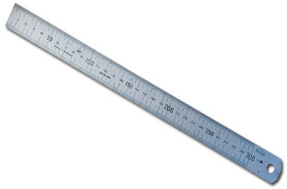

Basic Marking and Cutting Hand Tools
1. Steel ruler
- It is used to measure short distances.
2. Measuring Tape
- It is used to measure shorter or longer distances.

Slide 2
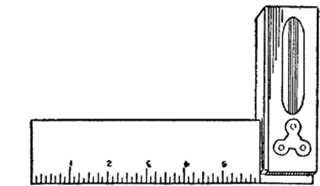
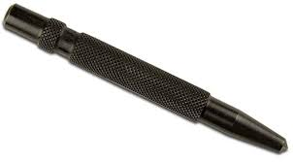
3. Engineer's Square
- It is used for checking square. (internal & external right angles)
4. Punch
- It is used for making pop marks.

Slide 3
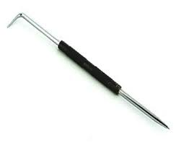
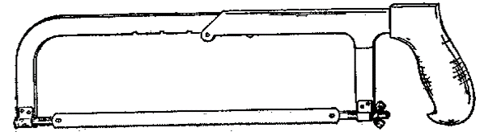
5. Scriber
- It is used for drawing lines.
6. Handsaw
- It is used for cutting metals.

Slide 4
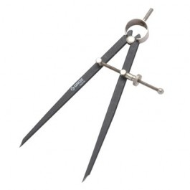

7. Divider
- It is used to draw arcs, circles, radii etc.
8. Files
- It is used as a cutting tool.

Slide 5
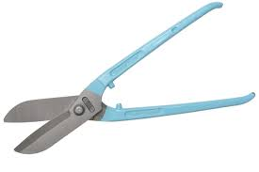

9. Tinsnip
- It is used for cutting sheet-metals.
10. Chisel
- It is used as a cutting tool.

Slide 6
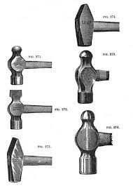
11. Hammers
It is used for general hammering in the workshop.
Video :
https://youtu.be/eXMXl0_8Pzk?si=I7YCGhJdRszun6AC
Feedback : Activity

Slide 7
Kwa Thema Skills School
Subject : Maintenance Marks: 10
Grade : Year 1 Time : 30 mins
Date : / / 2024
Question:1
1. Name the following marking and cutting hand tools.
1.__________________ 2.______________________
3.___________________ 4. ______________________

Slide 8
5. _________________ 6. ____________________
7. __________________ 8. ___________________
9. __________________ 10. ___________________
(10)

